Slide 1
Hypothesis Testing (Review)
STAT 4033 – Nonparametric Statistics

Slide 2
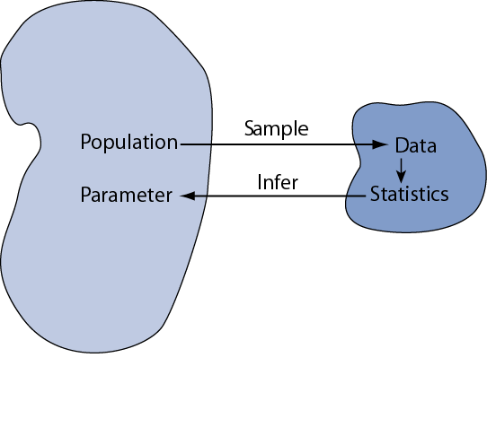
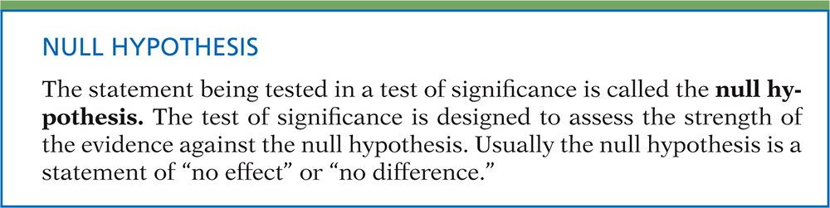

Hypothesis Testing
Statistical inference is the act of generalizing from a sample to a population with calculated degree of certainty.
Hypothesis Test
Do the data point us to this particular value?
(We have a value in mind from the outset.)
$$H_{0}:μ=μ_{0}$$

Slide 3
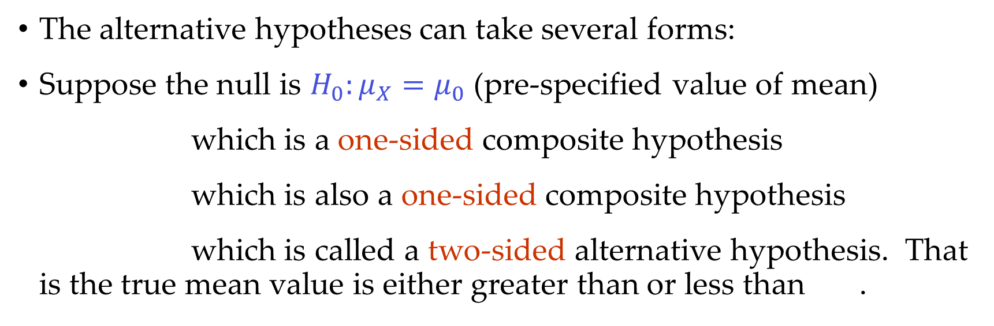
Null Hypothesis: H₀
This will be supported unless the data provide evidence that it is false
The status quo
Alternative Hypothesis: H_{a}
This will be supported if the data provide sufficient evidence that it is true
The research hypothesis
The alternative hypotheses can take several forms:
Suppose the null is $H_{0}:μ_{X}=μ_{0}$ (pre-specified value of mean)
which is a one-sided composite hypothesis
which is also a one-sided composite hypothesis
which is called a two-sided alternative hypothesis. That is the true mean value is either greater than or less than .

Slide 4
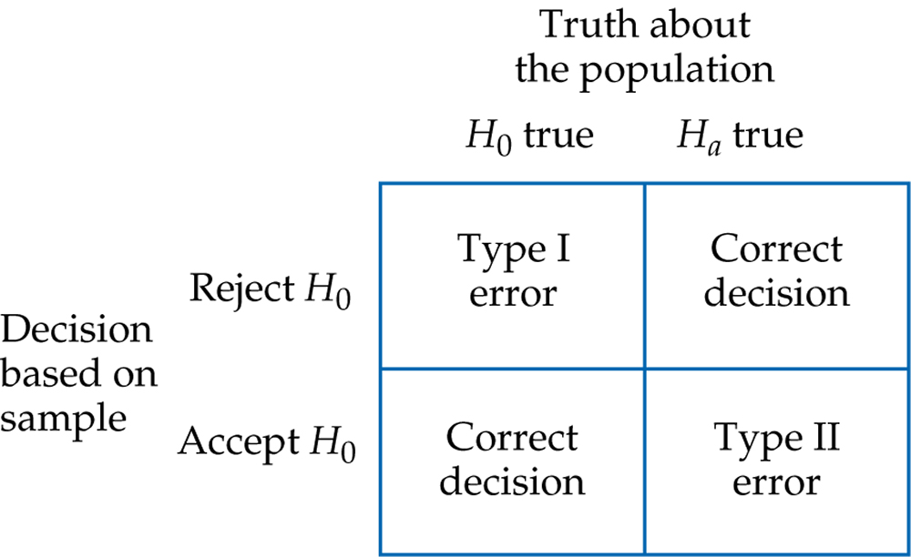
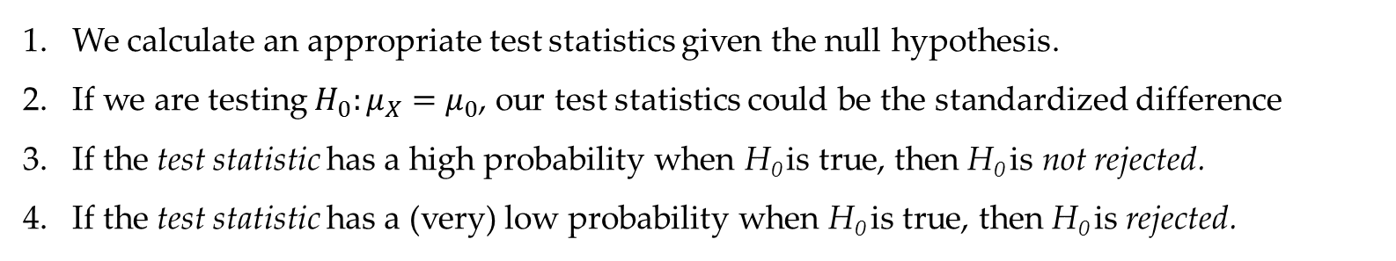
Elements of Hypothesis Testing
We calculate an appropriate test statistics given the null hypothesis.
If we are testing $H_{0}:μ_{X}=μ_{0}$, our test statistics could be the standardized difference
If the test statistic has a high probability when H₀ is true, then H₀ is not rejected.
If the test statistic has a (very) low probability when H₀ is true, then H₀ is rejected.
Figure 6.17
Introduction to the Practice of Statistics, Sixth Edition
© 2009 W.H. Freeman and Company

Slide 5
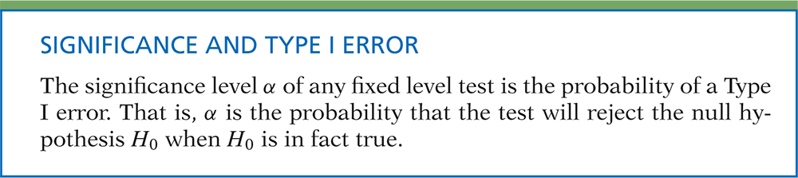
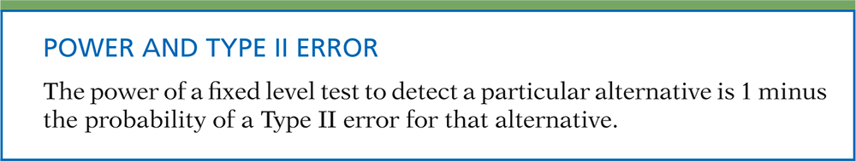
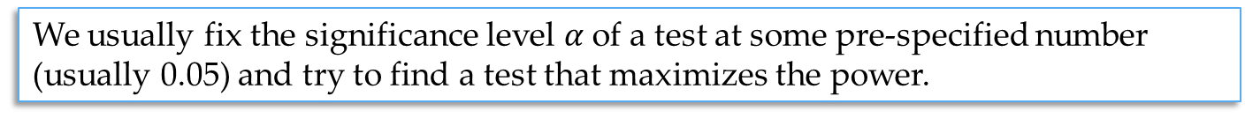
Type I and Type II errors
We usually fix the significance level $α$of a test at some pre-specified number (usually 0.05) and try to find a test that maximizes the power.

Slide 6
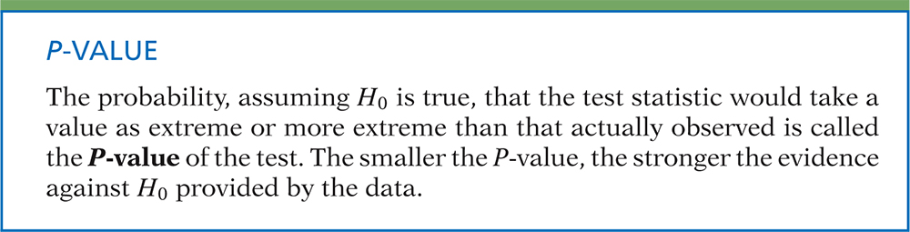
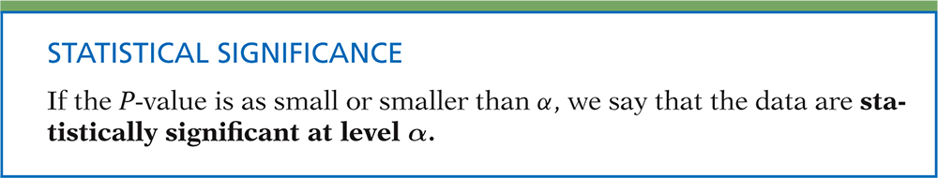
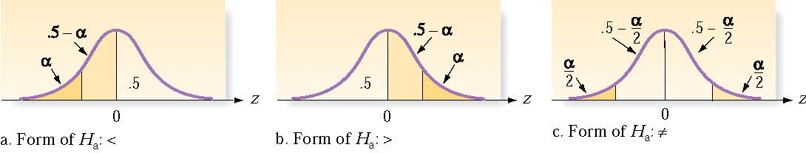
P-values
P-value is the probability that we would have seen our data (or something more unexpected) just by chance if the null hypothesis (null value) is true.
Small p-values mean the null value is unlikely given our data.
By convention, p-values of <.05 are accepted as “statistically significant”.
Rejection region: The values for the test statistic which lead to rejection of the null hypothesis

Slide 7
***Hypothesis testing conclusions
Note: Null hypotheses are either rejected, or else there is insufficient evidence to reject them. (I.e., we don’t say “accept” null hypotheses.)
P-value
> α < α
Do not reject H₀ Reject H₀
We do not have enough evidence We have evidence
to say that … (H_{a}) that … (H_{a})
α is the significance level, and we usually use 0.05 unless the problem states otherwise.

Slide 8
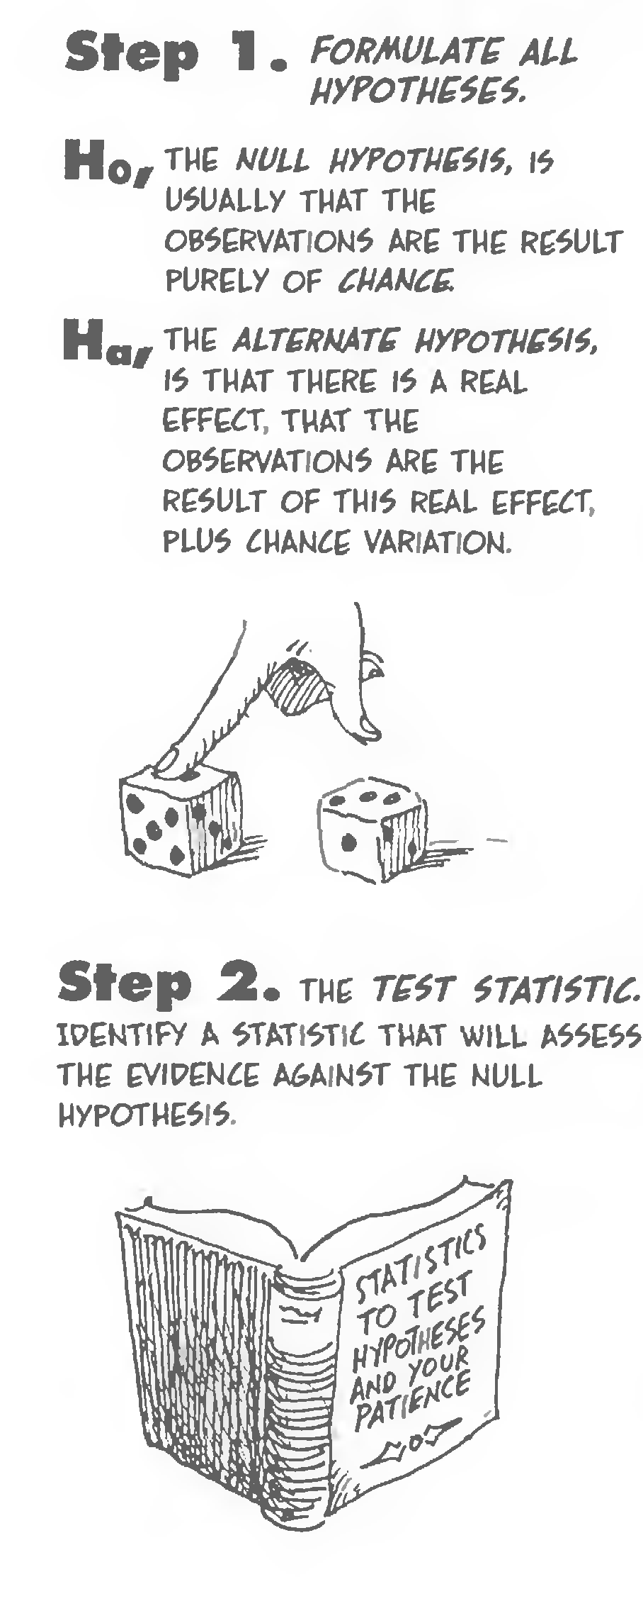
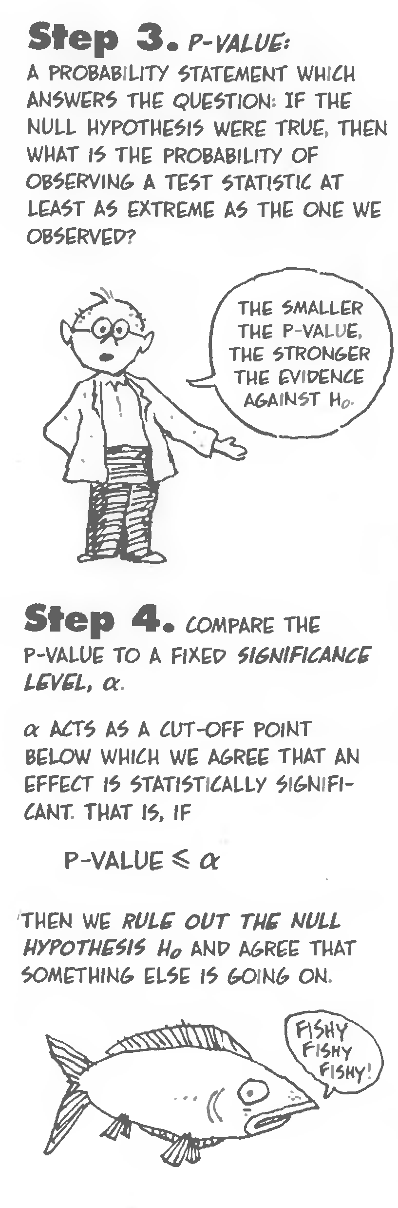

Slide 9
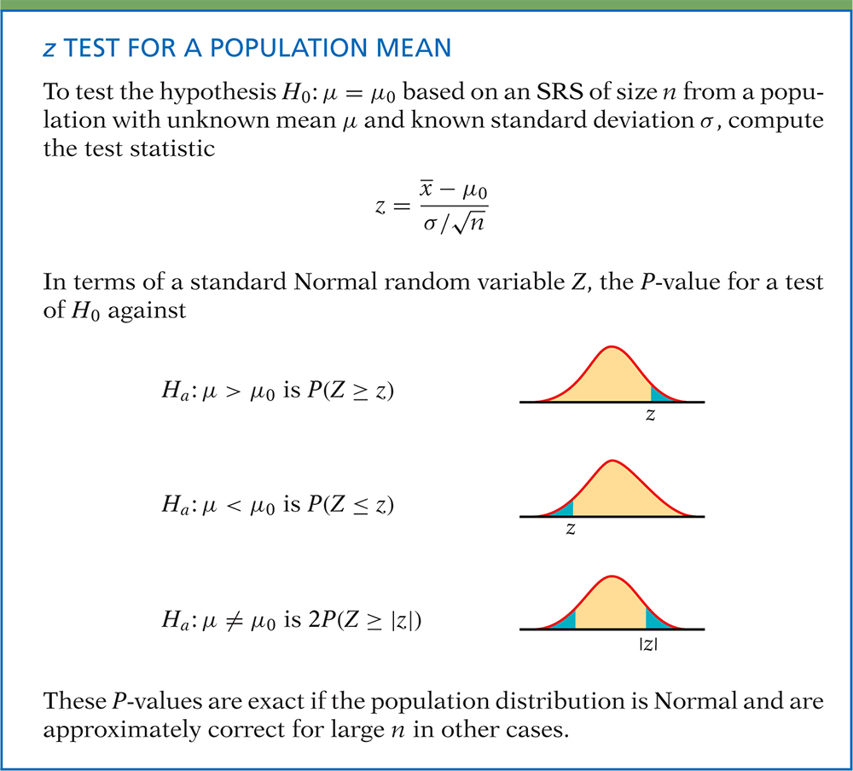
Definition, pg 383
Introduction to the Practice of Statistics, Sixth Edition
© 2009 W.H. Freeman and Company

Slide 10
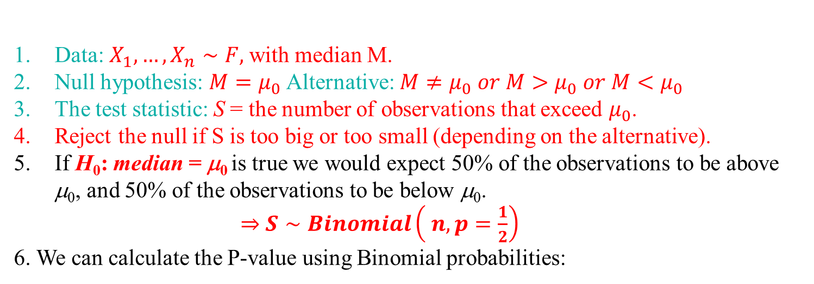
The Sign test:
Data: $X_{1}, …, X_{n}∼F,$with median M.
Null hypothesis: $M=μ_{0}$Alternative: $M≠μ_{0} or M>μ_{0} or M<μ_{0}$
The test statistic: S = the number of observations that exceed $μ_{0}$.
Reject the null if S is too big or too small (depending on the alternative).
If H₀: median = μ₀ is true we would expect 50% of the observations to be above μ₀, and 50% of the observations to be below μ₀.
$⇒$ $S∼Binomial\left( n, p=\frac{1}{2}\right)$
6. We can calculate the P-value using Binomial probabilities:
H_{a}: M < µ₀
H_{a}: M ≠ µ₀
H_{a}: M > µ₀
H₀: M = µ₀
Two-tailed P-value = $P_{\left\{S∼Bin\left(n,\frac{1}{2}\right)\right\}} ( S≥S(obs.)$) + $P_{\left\{S∼Bin\left(n,\frac{1}{2}\right)\right\}} \left( S≤S\left(obs.\right)\right)$

Slide 11
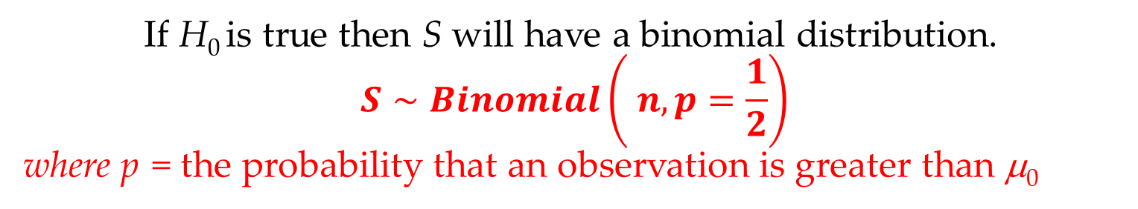
If H₀ is true then S will have a binomial distribution. $$S∼Binomial\left( n, p=\frac{1}{2}\right)$$ where p = the probability that an observation is greater than μ₀
50%
50%
Median = μ₀

Slide 12
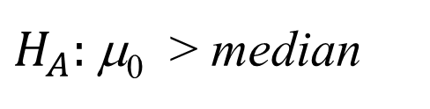
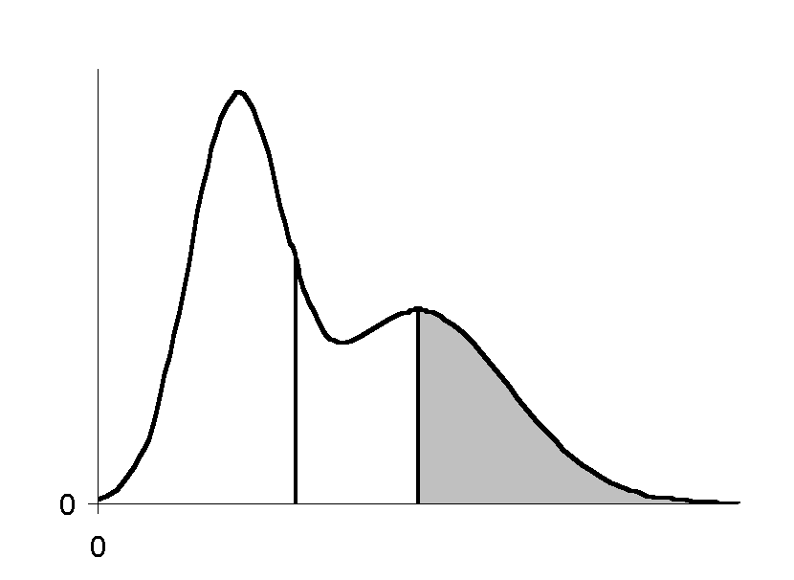
If H ₀ is not true then S will still have a binomial distribution. However p will not be equal to 0.50.
$H_{A}:$μ₀ > median
p < 0.50
p
Median μ₀

Slide 13
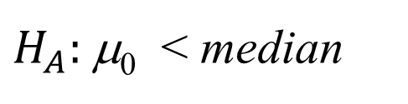
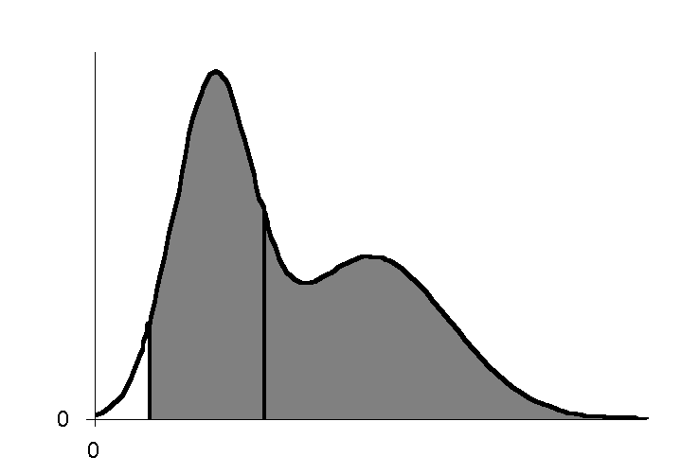
If H ₀ is not true then S will still have a binomial distribution. However p will not be equal to 0.50.
$H_{A}:$μ₀ < median
p > 0.50
p
μ₀ < Median

Slide 14
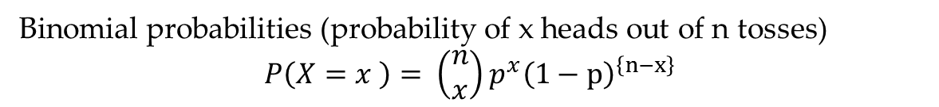
Summarizing: If H ₀ is true then S will have a binomial distribution with p = 0.50, n = sample size.
n = 10
Binomial probability mass function
Binomial probabilities (probability of x heads out of n tosses)
$$P\left(X=x \right)= \left(\begin{aligned}n \\ x\end{aligned}\right)p^{x}{\left(1−p\right)}^{\left\{n−x\right\}}$$

Slide 15
The critical and acceptance region:
n = 10
Binomial probability mass function
Choose the critical region so that α is close to 0.05 or 0.01.
e. g. If critical region is {0,1,9,10} then α = .0010 + .0098 + .0098 +.0010 = .0216

Slide 16
e. g. If critical region is {0,1,2,8,9,10} then α = .0010 + .0098 +.0439+.0439+ .0098 +.0010 = .1094
n = 10
Binomial probability mass function

Slide 17
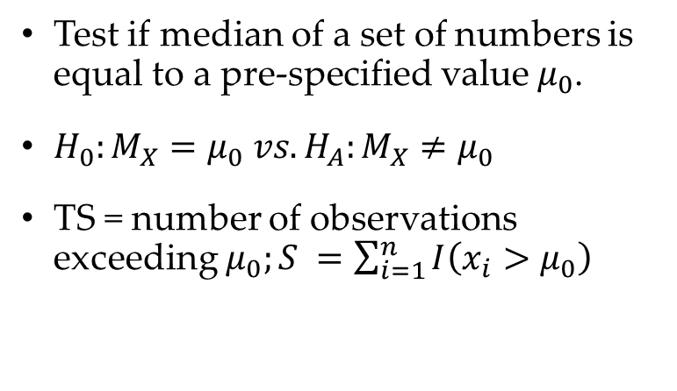
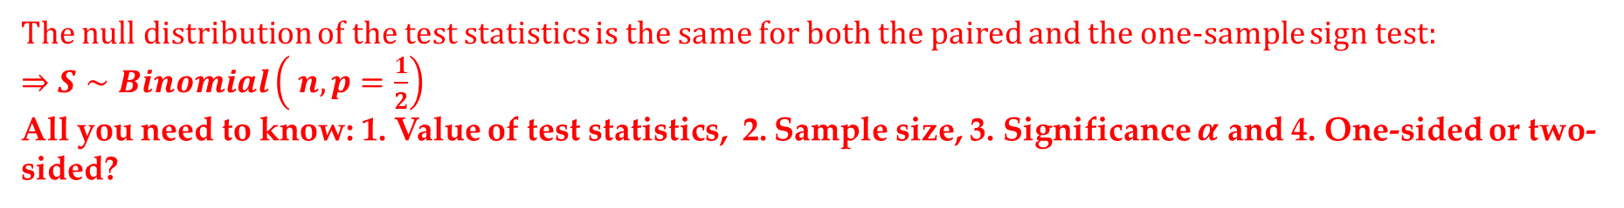
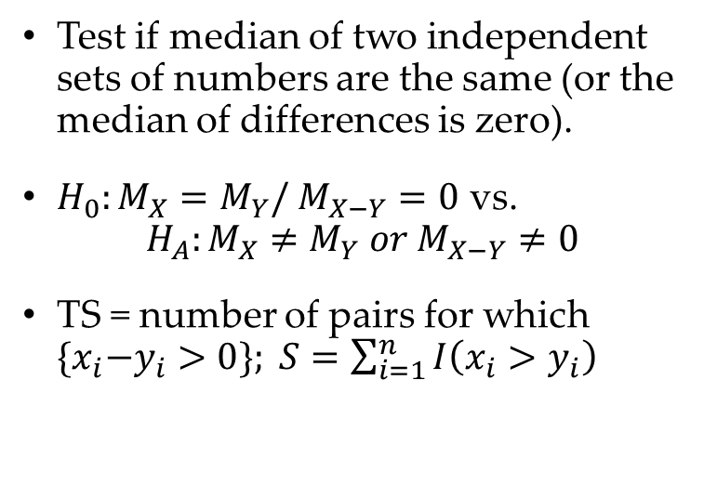
Varieties of Sign test
One-sample sign test
Paired sample Sign test
Test if median of a set of numbers is equal to a pre-specified value $μ_{0}$.
$H_{0}:M_{X}=μ_{0} vs. H_{A}:M_{X}≠μ_{0}$
TS = number of observations exceeding $μ_{0};S =\sum_{i=1}^{n}{I\left(x_{i}>μ_{0}\right)}$
Test if median of two independent sets of numbers are the same (or the median of differences is zero).
$H_{0}:M_{X}=M_{Y}/ M_{X−Y}=0$ vs.
$$H_{A}:M_{X}≠M_{Y} or M_{X−Y}≠0$$
TS = number of pairs for which ${\{x}_{i}−y_{i}>0\}; S=\sum_{i=1}^{n}{I\left(x_{i}>y_{i}\right)}$
The null distribution of the test statistics is the same for both the paired and the one-sample sign test:
$⇒$ $S∼Binomial\left( n, p=\frac{1}{2}\right)$
All you need to know: 1. Value of test statistics, 2. Sample size, 3. Significance $α$ and 4. One-sided or two-sided?

Slide 18
Example
Suppose that we are interested in determining if a new drug is effective in reducing cholesterol.
Hence we administer the drug to n = 10 patients with high cholesterol and measure the reduction.

Slide 19
The Sign test
The test statistic
S = the no. of positive observation = 8
We will use the p-value approach
p-value = P[S ≥ 8]
= 0.0439 + 0.0098 + 0.0010
= 0.0547
Since p-value > 0.05 we cannot reject H₀

Slide 20
Suppose we want to test
H₀: the drug is not effective
median reduction ≤ 0
against
H_{A}: the drug is effective
median reduction > 0
The Sign test
S = the no. of positive obs

Slide 21
Summarizing: To carry out Sign Test
We
Compute S = The # of observations greater than μ₀
Let s_{observed} = the observed value of S.
Compute the p-value = P[S ≥ s_{observed}]
(2 P[S ≥ s_{observed}] for a two-tailed test).
Use the table for the binomial dist’n (p = ½ , n = sample size)
Conclude H_{A} (Reject H₀) if p-value is less than 0.05 (or 0.01).

Slide 22
Intro to R
Next week:
Central limit theorem.
Sign test for large sample (using CLT)
Wilcoxon signed-rank test
Wilcoxon rank sum test
Real data examples
How to plot graphs and read data and draw random numbers.

